Slide 1
My P1 drawing machine visualizes daily life as abstract images.
By combining this with generative AI, we conducted an experiment to add emotional 'Mood' elements, such as 'happiness' or 'sadness,' to the images created through the web survey.
This is a process of exploring unexpected artwork by combining data-driven, logical visualization with the emotional reinterpretation of AI.

Slide 2
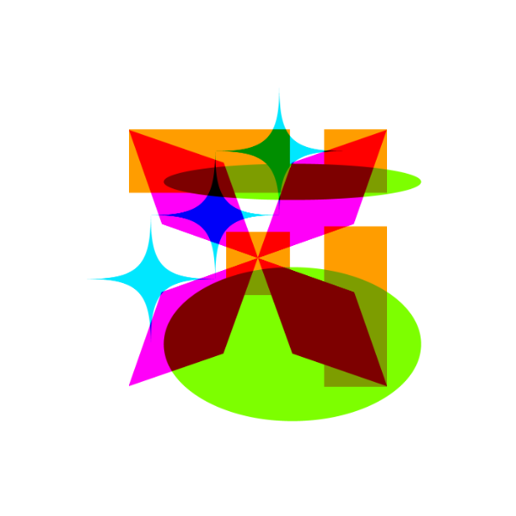
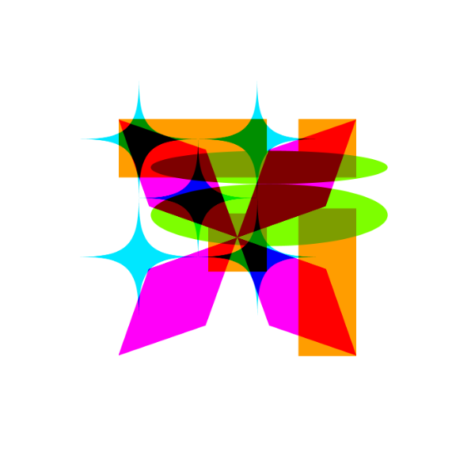
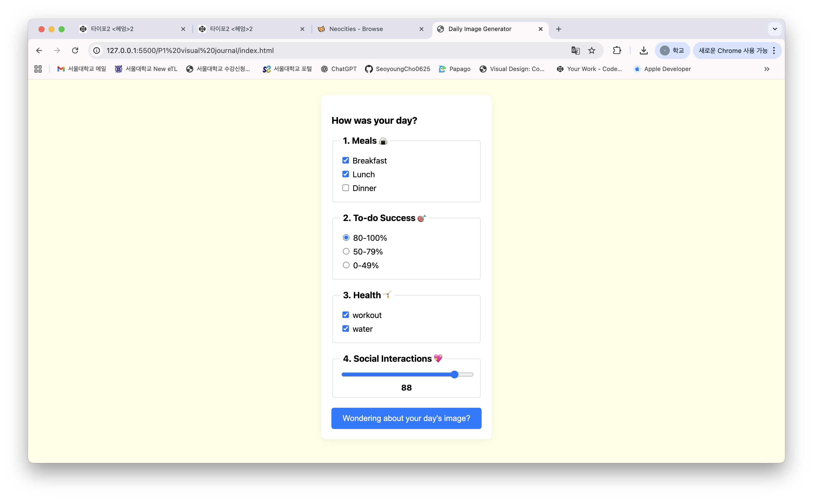

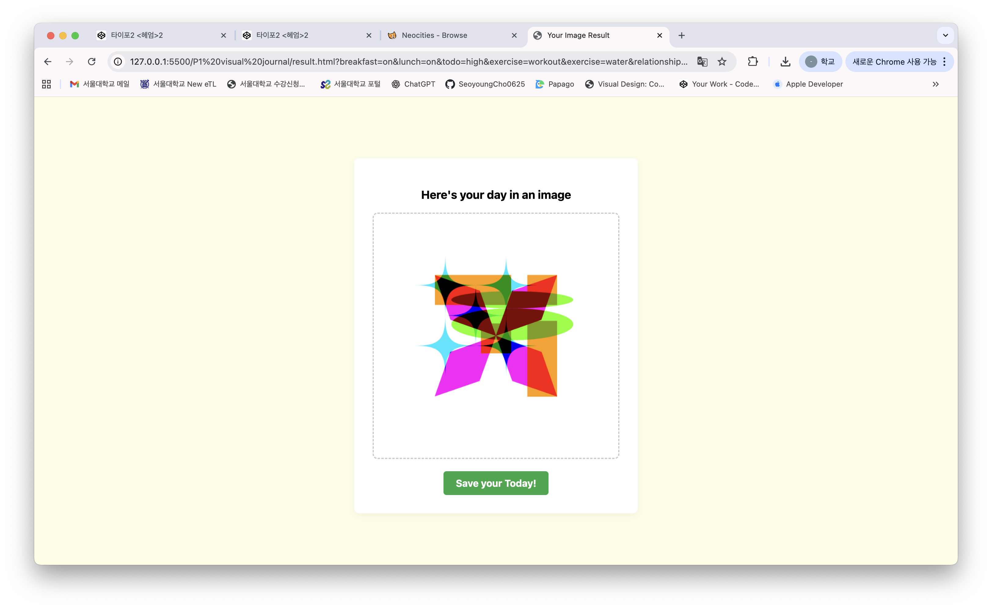

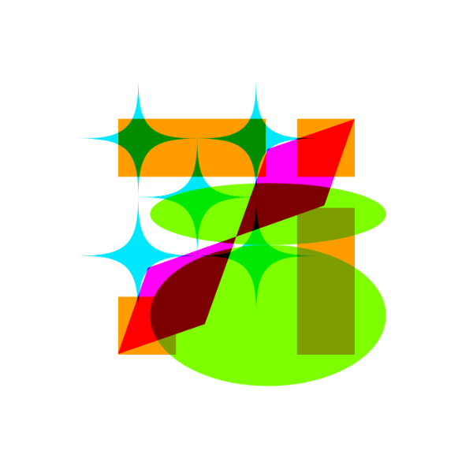

Slide 3
Daily life
In image
mood
Ai (nano banana)

Slide 4
An abstract composition in the style of Wassily Kandinsky, vibrant colors, geometric shapes, dynamic lines, inspired by the uploaded image. add happiness elements

Slide 5
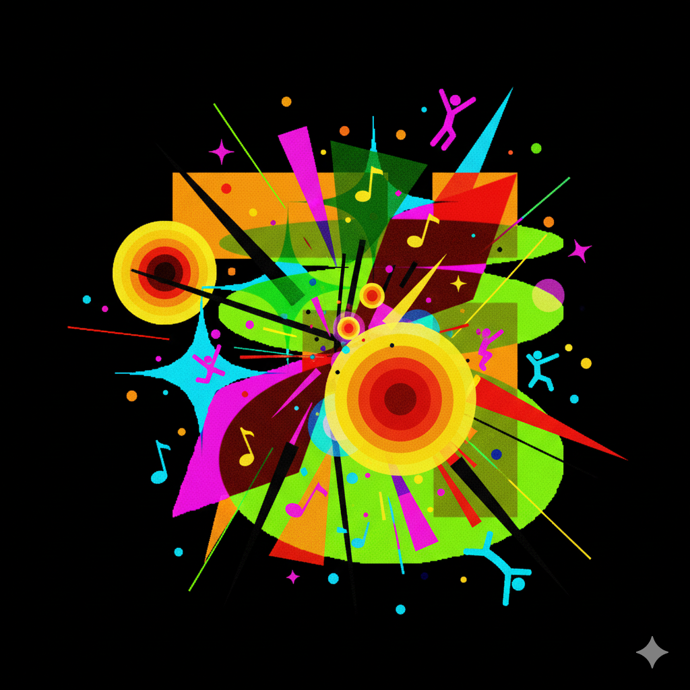
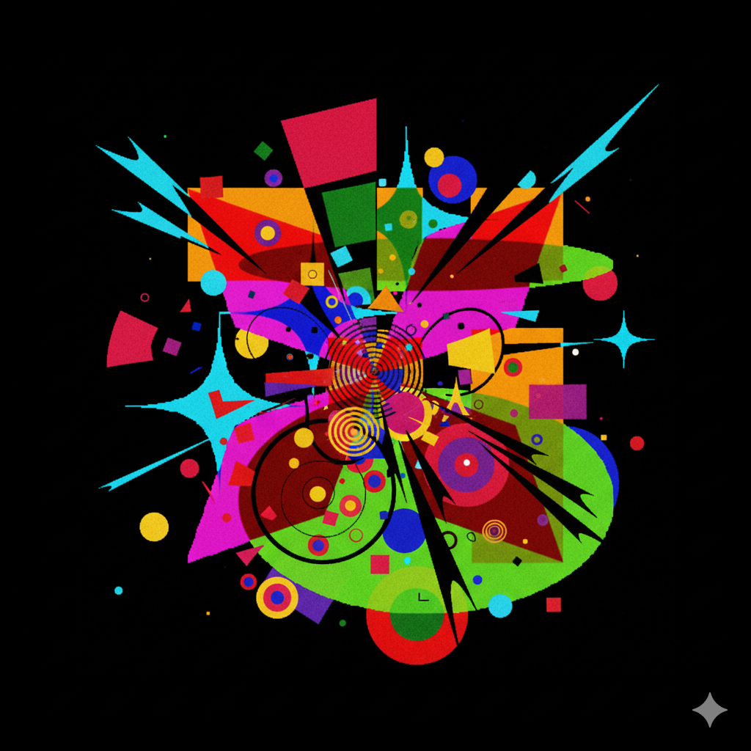

Slide 6
An abstract composition in the style of Wassily Kandinsky, vibrant colors, geometric shapes, dynamic lines, inspired by the uploaded image. add sadness elements

Slide 7
